Slide 1
Food Supply Management System Using BlockChain Technology
V.Sai Krupa Under the guidance of
18B81D5811 Dr. A. Vani Vathsala
Professor, Dept Of CSE

Slide 2
Topics
Abstract
Introduction
Blockchain
Remodeling In Food Supply Chain
How Food Supply Chain Works using Blockchain
Class Diagram
Sequence Diagram
Transaction Mechanism
Implementation
Screenshots
Conclusion
References

Slide 3
Abstract
Food supply chain mainly comprises of farmer, distributors, retailers and end user. In existing, Food supply chain distributors make maximum profit where as farmers and customers are at loss.
Now-a-days several web based food supply management systems are prevalently being used. Such FSMs are insecure and are prone to data tampering.
Even when they are protected with secure data and a password, they can be altered if the user’s password has been hacked, which means the traditional methods of record keeping are insecure.
Block chain has a decentralized architecture which stores and secures transactions transparently and there will be no central authority over those occurring transactions.
So, a model is implemented which uses the core technology of the Block-chain to store securely the transactions that take place in food supply chain. Even if the data is tampered it can be detected easily.

Slide 4
Introduction
Currently, it is impossible for the consumers or retailers to access the information related to the original price of food items as sold by farmers.
But in the supply chain technology, blockchain can improve the transparency in pricing by connecting multiple stakeholders like farmers, distributors, retailers, and consumers.
Everyone within the network could have access to the transparent and immutable view of the transaction history.

Slide 5
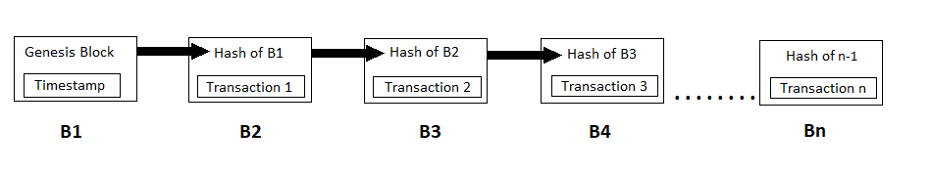
Blockchain
A blockchain is a digital, public ledger that records online transactions.
Blockchain is the core technology for cryptocurrencies like bitcoin.
A blockchain is a growing list of records, called blocks, which are linked using cryptography.
Each block contains a cryptographic hash of the previous block, a timestamp, and transaction data.
Since Transactions are stored in blocks by hashing technique they cannot be modified by third parties.
Even if the particular data block is altered, its integrity is verified with the help of hash in the previous block. So user can identify the data as tampered.

Slide 6
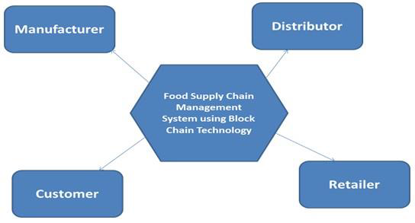
Blockchain- Remodeling Food Supply Chain
Blockchain could bring transparency to the system by connecting the following stakeholders directly-
Manufacturer
Distributor
Retailer
Customer

Slide 7
How food supply chain works using blockchain
Farmers could store the information about food crops prices on a central location in the blockchain.
After receiving the block created by farmer, food processing companies or distributors can create their block for the crops purchased by them.
Information stored on the blockchain could help retailers or consumers verify if the food has been appropriately priced or not.

Slide 8
Apart from pricing details, information such as crop origination details, batch numbers, transportation details, factory and processing data, storage temperature, expiration details, and other details can be linked digitally to the food items within the supply chain blockchain.
Every piece of information captured during each transaction is validated by all stakeholders in the network.
After validating every block, it is added to the entire chain of transactions, creating an immutable and permanent record.

Slide 9
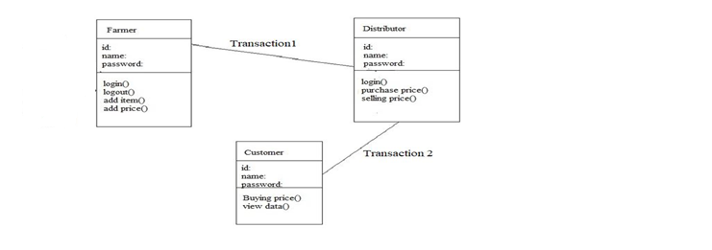
Class diagram

Slide 10
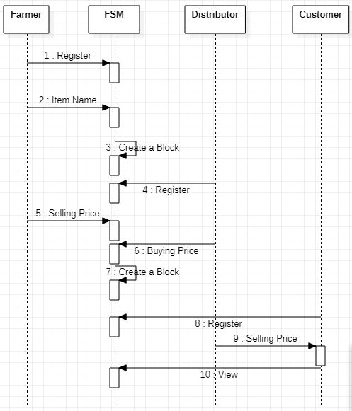
Sequence Diagram

Slide 11
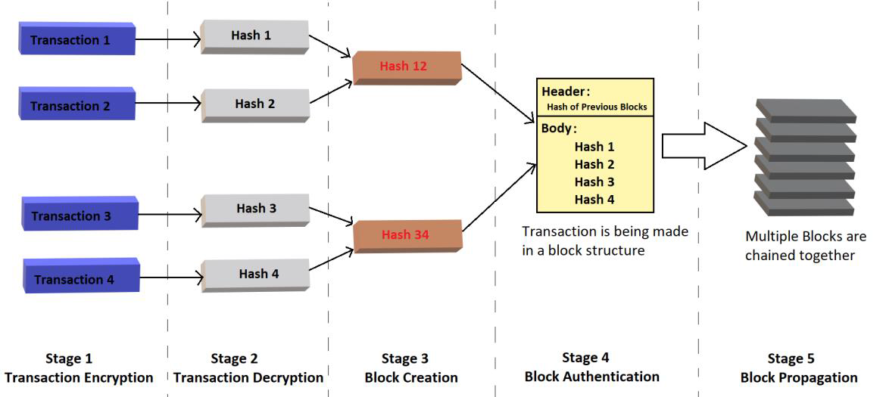
TRANSACTION MECHANISM
It can be defined in five stages such as Transaction Encryption, Transaction Decryption, Block Creation, Block Authentication and Block Propagation.

Slide 12
Transaction Encryption : The data owner will initiate the transaction in which the details of the receiver’s public key, receiver’s address and the transactional value is specified.
Transaction Decryption : The signed transaction is sent to the network, and received by the all nodes of the network. Then the message will be validated by decrypting the digital signature.
Block Acknowledgement : Any node in the network takes the initiation to create a block by combining with all other decrypted transactions which are in the waiting state.

Slide 13
Block Authentication : The nodes, after receiving the block copies, start an interactive process to validate it and communicate with each other to check for single data value over a system
Block Propagation : Once a block is authenticated, it will be registered in the network as a verified block. Next block will be linked to the recently verified block.

Slide 14
IMPLEMENTATION
Algorithm
Data Encryption Standard (DES) is a block cipher algorithm that takes plain text and converts them to cipher text using keys. It is a symmetric key algorithm, which means that the same key is used for encrypting and decrypting data.
begin
Step 1: for (i=1 to n)
T=gets();
Step 2: En(T);
Step 3: De(T) = A(Wi);
Step 4: for (Wi = 1 to n)
A(W1) + A(W2) + A(W3) +…+ A(Wn) = B[Wi];
Step 5: Hash {B[Wi]} = A(pi);
Step 6: for (pi = 1 to n)
A(p1) + A(p2 + Hash(p1))+ A(p3 + Hash(p2))+…+ A(pn + Hash(pn-1)) = BC[T];
go to: Step 1
end if T= null;

Slide 15
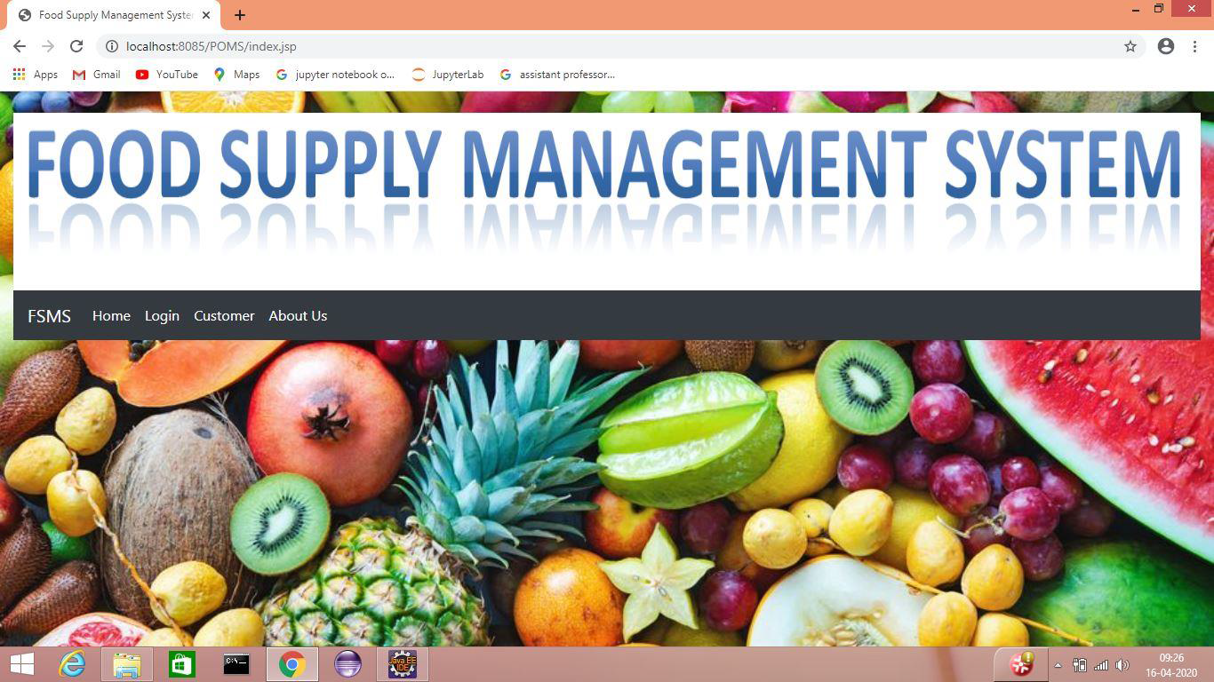
SCREENSHOTS
Home page

Slide 16
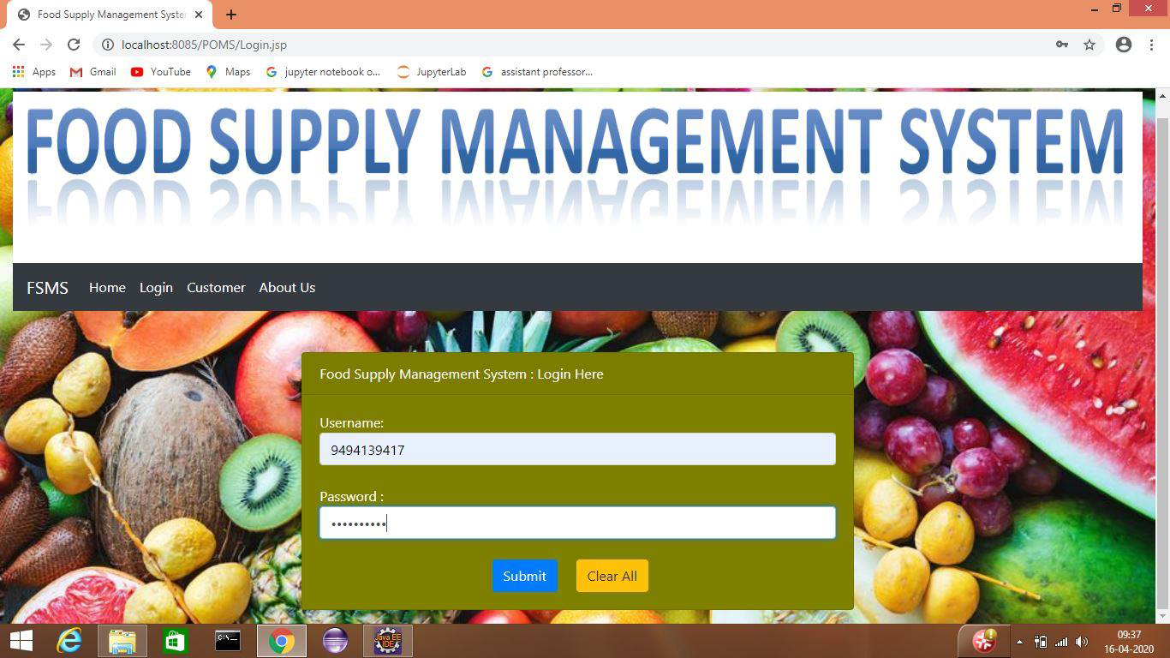
Login Page

Slide 17
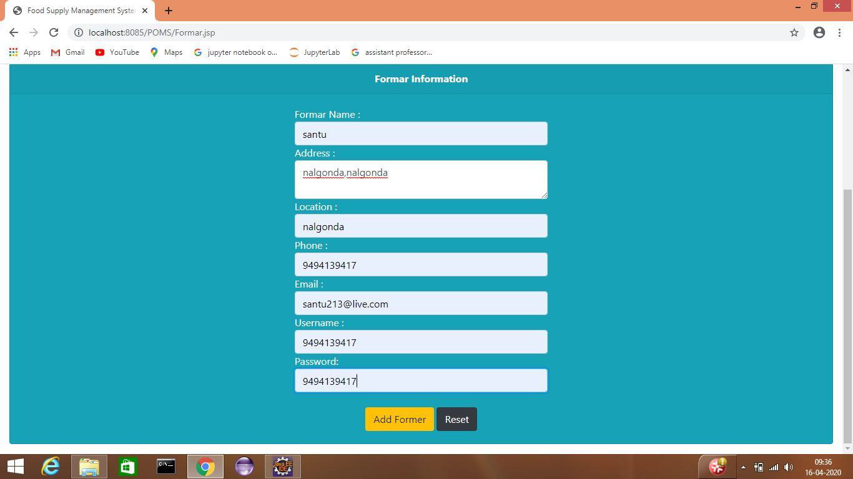
Farmer Registration Page

Slide 18
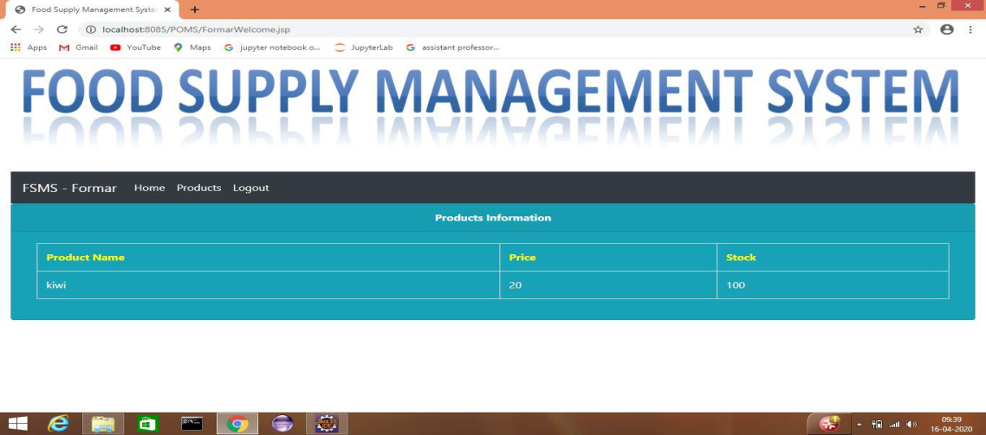
Food Details

Slide 19
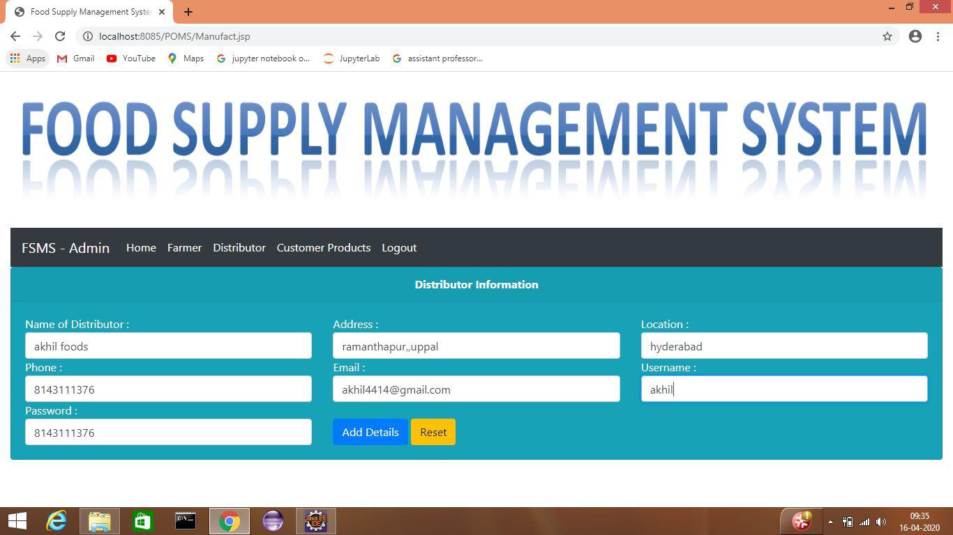
Distributor Registration Page

Slide 20
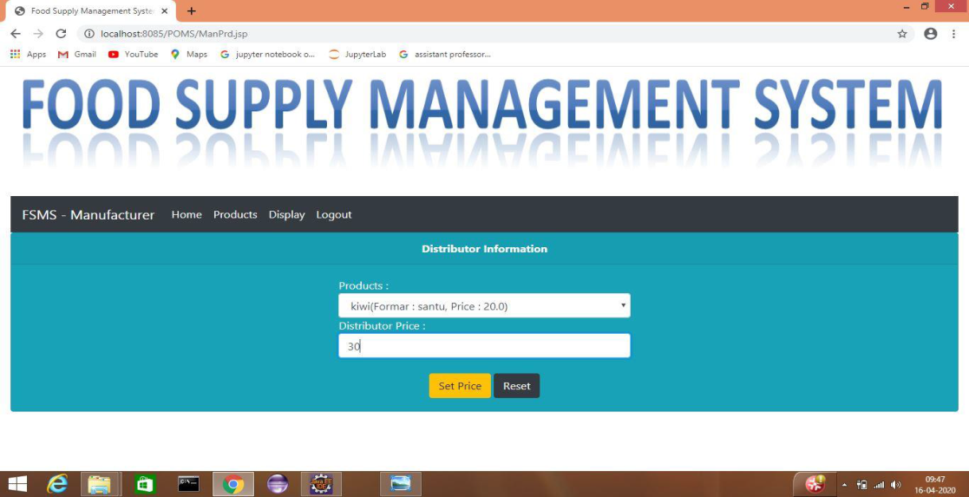
Transaction

Slide 21
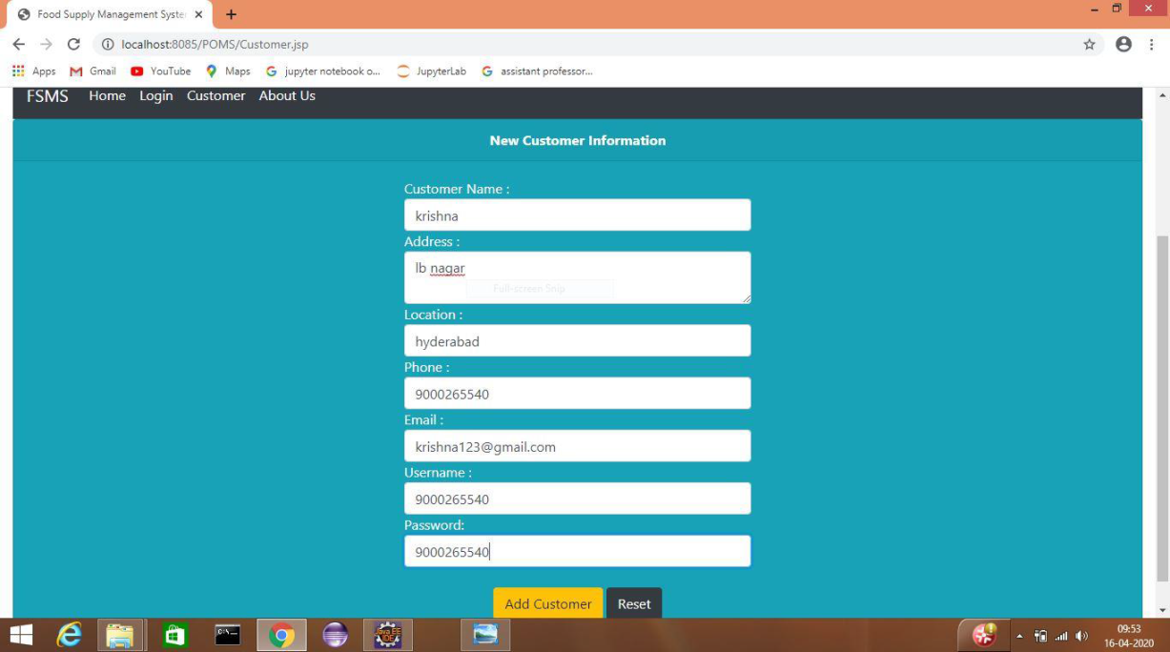
Customer Registration Page

Slide 22
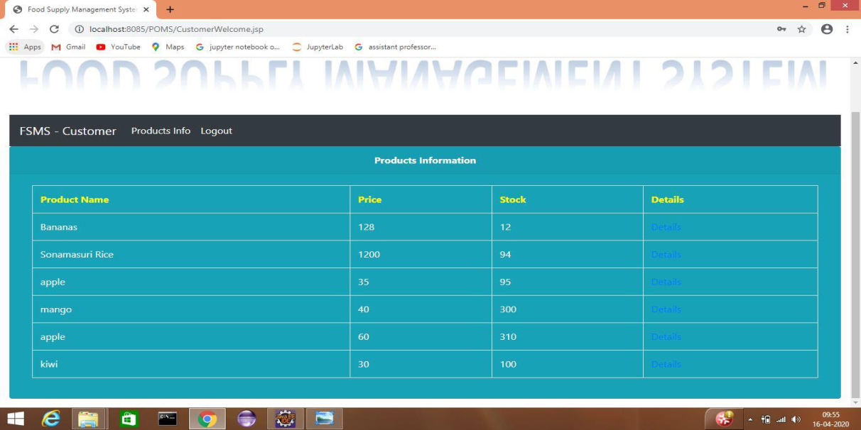
Customer View

Slide 23
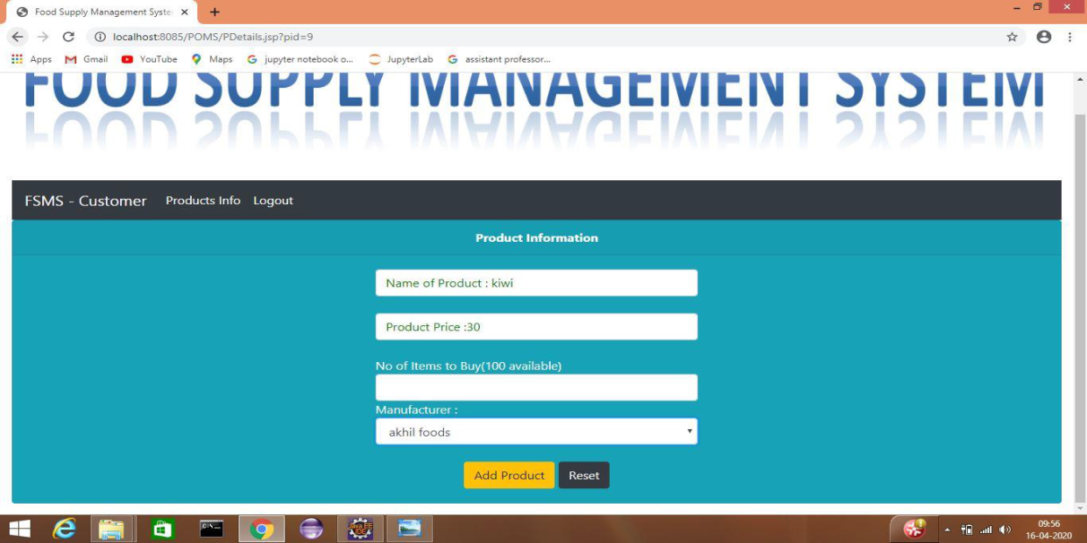
Transaction

Slide 24
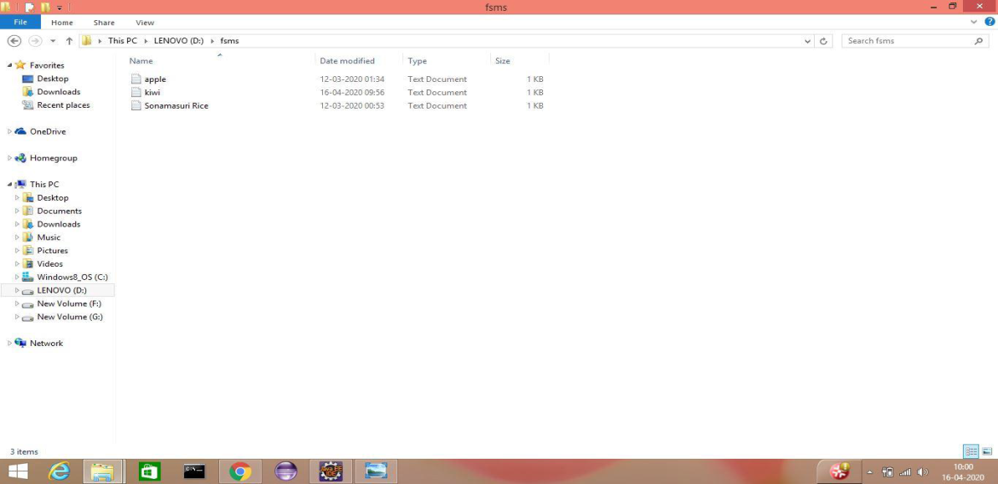
Creation Of Block

Slide 25
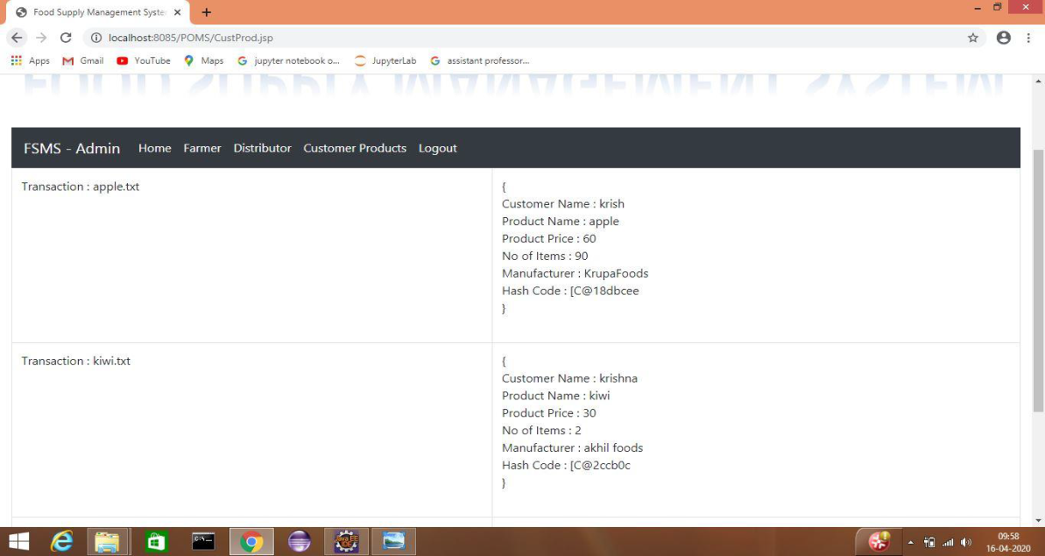
Viewing Transaction

Slide 26
CONCLUSION
Food Supply Chain Management System can be created however can't be changed by anybody including the data owner as like a genuine block chain, which guarantees that there is zero chance of information being altered.
All the individual transactions of every module are broadcasted to all the active nodes in the network which means each module contains every transaction-hash pair of all nodes.
Whenever a new transaction has been added by the data owner it will also be broadcasted and chained to existing blocks in the network.
This model especially takes care of the traditional issues of record keeping and their information security issues with the assistance of Block chain technology.
Since the represented model is an essential adaptation of how the information and transactions are secured utilizing Block chain technology.

Slide 27
References
KENTAROH TOYODA1, (Member, IEEE), P. TAKIS MATHIOPOULOS2, (Senior Member, IEEE), IWAO SASASE1, (Senior Member, IEEE), AND TOMOAKI OHTSUKI1, (Senior Member, IEEE). A Novel Block chain-Based Product Ownership Management System (POMS) for Anti-Counterfeits in the Post Supply Chain.
Z. Zheng, S. Xie, H. Dai, X. Chen, and H. Wang, in Proc. IEEE Int. Congr. Big Data (BigData Congr.), Jun. 2017, pp. 557–564. “An overview of block chain technology: Architecture, consensus, and future trends’’[Online] Available: http://ieeexplore.ieee.org/document/ 8029379/
Caro, M.P., M.S. Ali, M. Vecchio, and R. Giaffreda. 2018. "Blockchain-based traceability in Agri-Food supply chain management: A practical implementation." IoT Vertical and Topical Summit on Agriculture-Tuscany (IOT Tuscany). IEEE. 1-4.
“Block chain Applications: A Hands-On Approach (2017)”Author: ArshdeepBahga,VijayAvailable:https://books.google.co.in/books?id=M7sanQAACAAJ&redir_esc=y&hl=en

Slide 28
Thank you!!

